Slide 1



Extended Jacobian
Simultaneous control of mobile base and robotic arm for a Kuka You Bot
Romit Mohanty

Slide 2
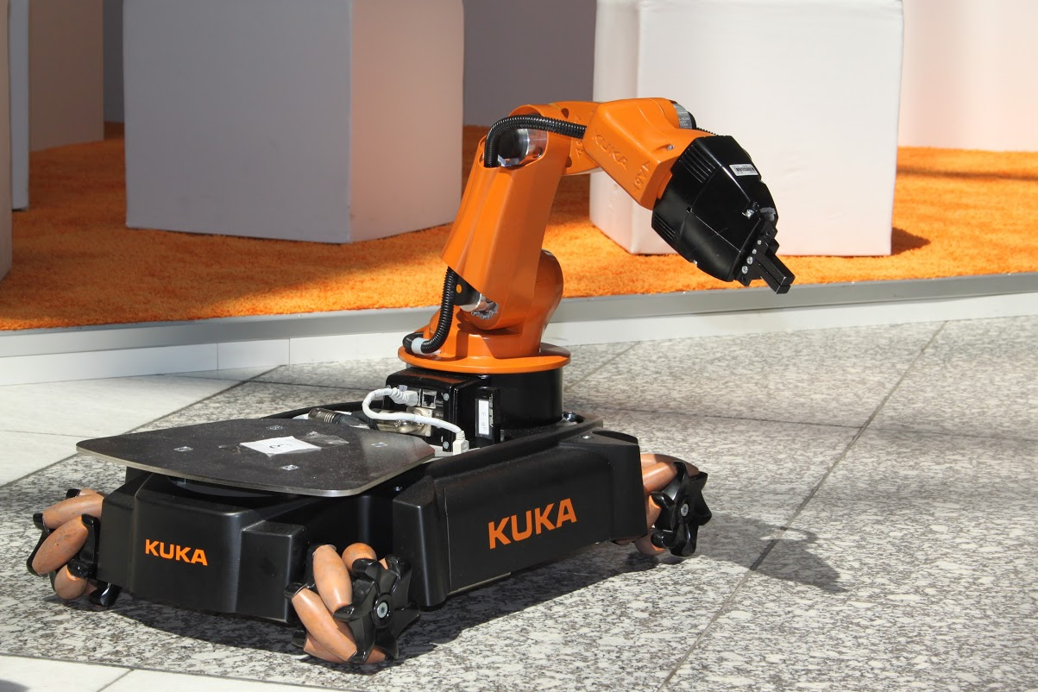
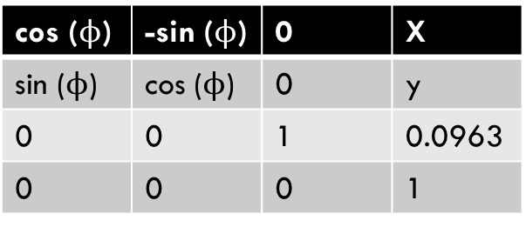
Parameters of you bot
Consists of a mobile base and a 5 DOF arm.
M_{0e=}
M_{0e} is the end effector frame {e} w.r.t base frame
{0} when all joint angles are 0 (home config)
T_{b0}=
T_{b0} is the fixed offset from the chassis frame {b} to the base frame of the arm {0}.
T_{sb} is the configuration of the base frame {b} of
the mobile base relative to the frame {s} on the floor
T_{sb}=
1 | 0 | 0 | 0.033
0 | 1 | 0 | 0
0 | 0 | 1 | 0.6546
0 | 0 | 0 | 1
1 | 0 | 0 | 0.1662
0 | 1 | 0 | 0
0 | 0 | 1 | 0.0026
0 | 0 | 0 | 1
cos ($ϕ$) | -sin ($ϕ$) | 0 | X
sin ($ϕ$) | cos ($ϕ$) | 0 | y
0 | 0 | 1 | 0.0963
0 | 0 | 0 | 1

Slide 3

Project details
I completed this project using 3 milestones.
First, I wrote a code for the NextState function which takes input as the following
A 12-vector representing the current configuration of the robot (3 variables for the chassis configuration, 5 variables for the arm configuration, and 4 variables for the wheel angles).
A 9-vector of controls indicating the arm joint speeds $ω$ (5 variables) and the wheel speeds u (4 variables).
A timestep Δt.
A positive real value indicating the maximum angular speed of the arm joints and the wheels. For example, if this value is 12.3, the angular speed of the wheels and arm joints is limited to the range [-12.3 radians/s, 12.3 radians/s]. Any speed in the 9-vector of controls that is outside this range will be set to the nearest boundary of the range. If you don't want speed limits, just use a very large number. If you prefer, your function can accept separate speed limits for the wheels and arm joints.
Output: A 12-vector representing the configuration of the robot time Δt later.
new arm joint angles = (old arm joint angles) + (joint speeds) * Δt
new wheel angles = (old wheel angles) + (wheel speeds) * Δt
new chassis configuration is obtained from odometry.

Slide 4
MILESTONE 2:TRAJECTORY GENERATOR
The total trajectory for picking up a block from a given place and keeping it at another place and then returning to its original position can be made to comprise of 9 independent trajectories.
A trajectory to move the gripper from its initial configuration to a "standoff" configuration a few cm above the block.
A trajectory to move the gripper down to the grasp position.
Closing of the gripper.
A trajectory to move the gripper back up to the "standoff" configuration.
A trajectory to move the gripper to a "standoff" configuration above the final configuration.
A trajectory to move the gripper to the final configuration of the object.
Opening of the gripper.
A trajectory to move the gripper back to the "standoff" configuration.
A trajectory to move the gripper to a "standoff" configuration above the initial home configuration.
These above trajectory can be realized using the SCREWTRAJECTORY function from the MODERN ROBOTICS
Code library.

Slide 5


MILESTONE 3: FEEDFORWARD CONTROL
Control law to be used is
$ $(t)=[Ad_{X-1Xd}] $$_{d}(t) + K_{p}X_{err}(t) + K_{i} $\int_{0}^{t}{Xerr\left(t\right)dt}$
Input :
The current actual end-effector configuration X (also written T_{se}).
The current end-effector reference configuration X_{d} (i.e., T_{se,d}).
The end-effector reference configuration at the next timestep in the reference trajectory, X_{d,next} (i.e., T_{se,d,next}), at a time Δt later.
The PI gain matrices K_{p} and K_{i}.
The timestep Δt between reference trajectory configurations.
Output:
The commanded end-effector twist $$ expressed in the end-effector frame {e}.
= J_{e}⁺($θ$) $$
This calculated u,w sent to NEXTSTATE FUNCTION.
u
$$w$$

